Slide 1
Interactive Bioinformatics Data Visualisation Course
Jitender
Marielle
11 May 2023
Informatics@
CSB

Slide 2
Schedule
Interactive Bioinformatics Data Visualisation Course
10:00 Welcome/ Start/ Introduction
11.15 – 11.30 Coffee Break
12.45 : Q&A and Discussion
Conclude @ 1:00pm

Slide 3
Agenda
Interactive Bioinformatics Data Visualisation Course
10:00 Start
11.15 – 11.30 Coffee Break
12.45 : Q&A and Discussion
Conclude @ 1:00pm

Slide 4
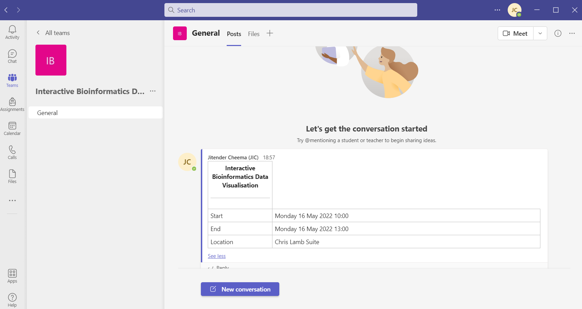
Material for the session
All at the Github page:
https://github.com/gitbackspacer/data-visualisation-course
Teams:
https://teams.microsoft.com/l/team/19%3ablbpBiRHRDsmSF-60bMWRygjxauHuby6JSuNMOPDQwQ1%40thread.tacv2/conversations?groupId=2812d720-685c-428d-9e0c-7eeea8e14048&tenantId=e652efd4-5dac-41b6-a23d-764634c36cea

Slide 5
Introduction
“Data is beautiful – it can inspire, improve lives and bring out the best in people”

Slide 6
Trends in biology papers
We will cover most common themes that we see (visualise) in bioinformatics papers
Alignment(protein/DNA) long sequences
Genes on different genomes(synteny) or their relations
Proportion of reads aligned to a Genome
RNAseq based gene expression data
Go terms
Gene Networks

Slide 7
Content
View Multiple sequence alignment (MSA) , an interactive example

Slide 8
Trouble with Genomics data visualisation
Data_ink / Total ink used to print the graphics
Colours
Fonts
Big Data can not load all at once
Showing sequence as reads intervals: reads doesn’t map to a point
Multiple data set into single view: not a single gene but neighbourhood
Multiple chromosomes and Whole genome context: all chromosome in a single view
Long range and complex variations
Excel sheets: “a useful container isn't automatically a useful presenter” The table presents individual data points very well and patterns that they compose very poorly.

Slide 9
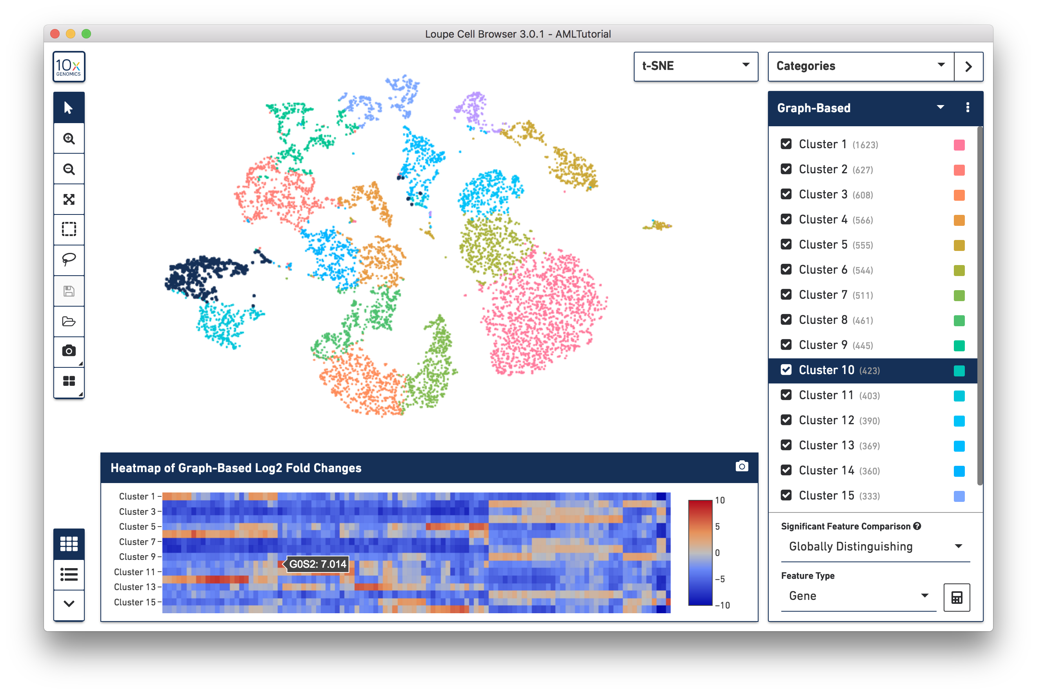
Big data
https://support.10xgenomics.com/single-cell-gene-expression/software/visualization/latest/what-is-loupe-cell-browser
Loupe Browser

Slide 10
The 25 Best Data Visualizations of 2023
https://visme.co/blog/best-data-visualizations
We can have a vote on this, which are your top 3
What features did you like ? and what lead to your ranking
I’m sure you would agree there is a space for “a bit of an artistic license”: lot of creativity is need to make a better data-viz displays
By: Anna Glivinska
https://visme.co/blog/best-data-visualizations-2018/
https://visme.co/blog/best-data-visualizations-2019/

Slide 11
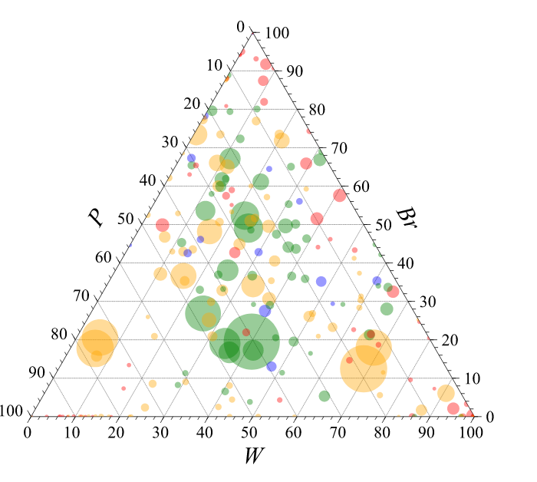
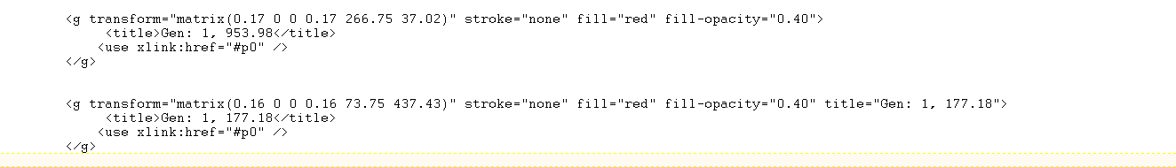
https://dash.gallery/Portal
Html5
CSS
SVG
“metagenomics.svg”

Slide 12
Exercise 1: MSA viewing

Slide 13
Viewing Multiple Sequence alignment(MSA)
https://dash.gallery/dash-alignment-chart/
Viewer shows gap and conservation alongside a standard colorscale support and consensus sequence
No matter what size your alignment is, Alignment Viewer is able to display your proteins snappily.
You can quickly scroll through your long sequence with a slider or a heatmap overview.
Data: https://github.com/gitbackspacer/data-visualisation-course/blob/master/msa/human-kinase20.fasta

Slide 14
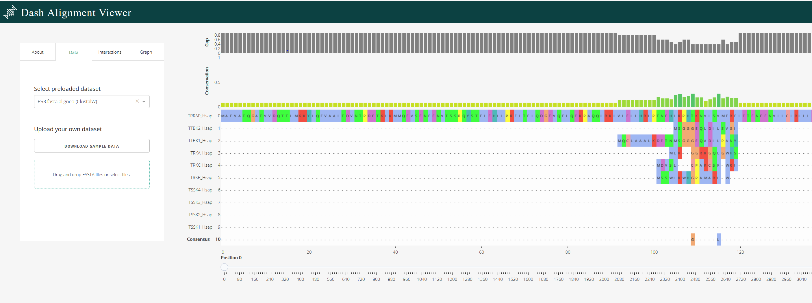
Alignment viewer step 1: Single Click on Drag drop Step 2: Browse the file “human-kinase20.fasta”
Aligned 20 Kinase Human proteins already using
Jalview “you can not only visualise but also edit”

Slide 15
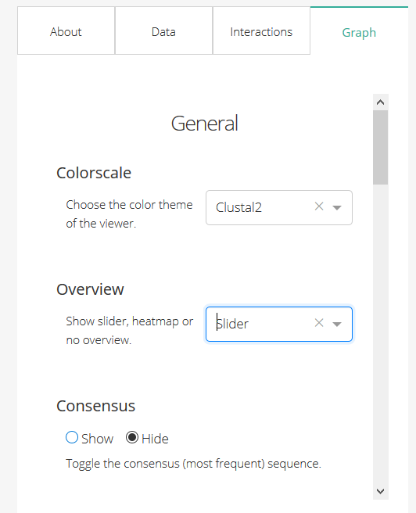
To Toggle to Slider

Slide 16
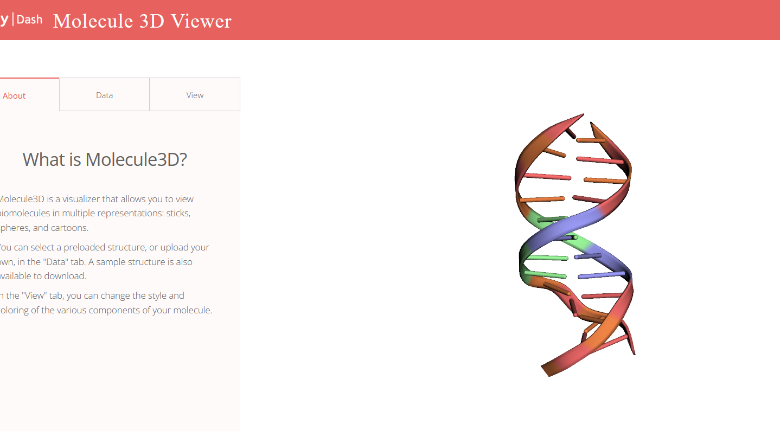
Molecule 3D Viewer
https://dash.gallery/dash-molecule-3d-viewer

Slide 17
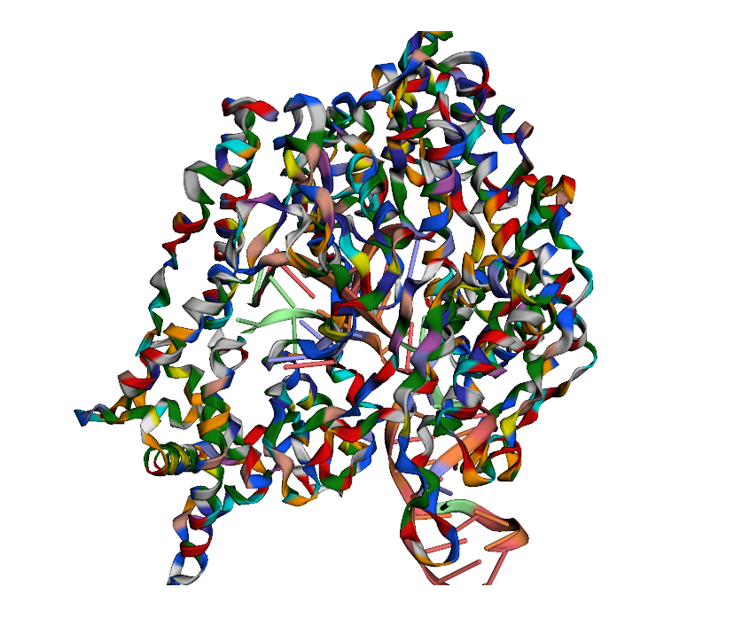
T7 RNA polymerase

Slide 18
Genomic data
Complex genomic changes:
copy number changes-
mutations
gene expressions
methylations patterns
Information buried all into sequencing results

Slide 19
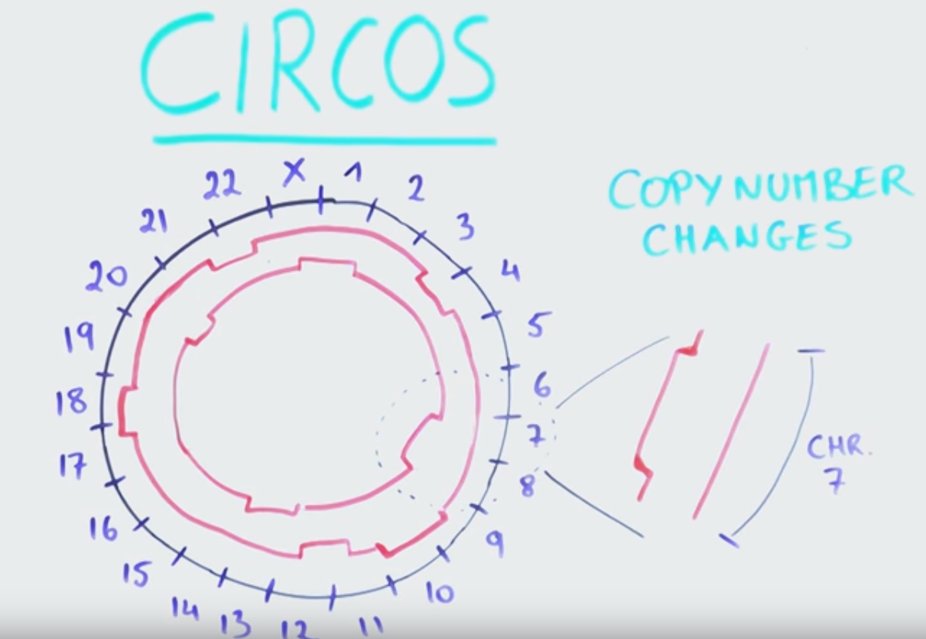
Gained or duplicated :outward
Lost: inwards
Compare two tumours or individuals
Thanks : YourekaScience https://www.youtube.com/watch?v=aY7-VFqwzlY

Slide 20
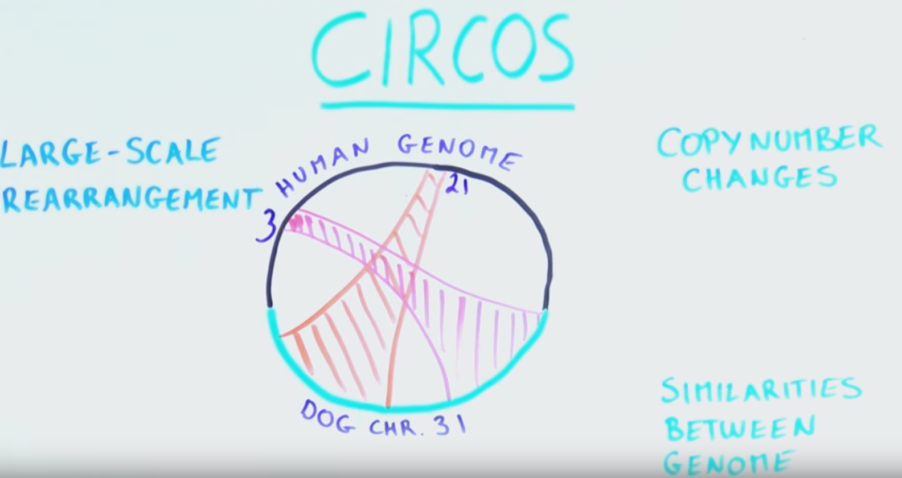
Thanks : YourekaScience https://www.youtube.com/watch?v=aY7-VFqwzlY

Slide 21
“methods to transform information into a visual form for comprehension”
automated processes can reliably find sites where rearrangement occurs, but visualization is then needed to provide a mental image so that the detail of structural variation can be fully appreciated and understood [Wong, Nature Methods volume 9: 1131 (2012)]

Slide 22
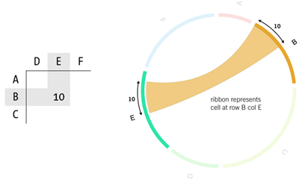
Circos
https://github.com/nicgirault/circosJS
- Please visit the link above to see how a Circos diagram can be customized
Circos is a circular visualization of data, must have seen on the cover of many Journals
Used to highlight relationships between genes, chromosome, etc for example genes that are located on different chromosomes in the genome of an organism(synteny)
http://circos.ca/intro/tabular_visualization/img/circos-visualize-table.png

Slide 23
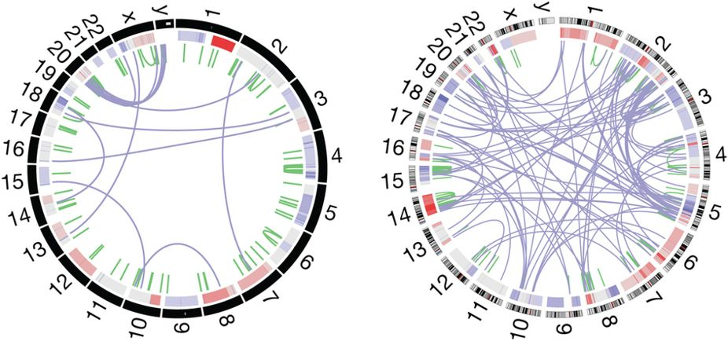
Visualisation of whole-genome rearrangement.
Two different tumours showing gene duplications and chromosome rearrangements.
The outer ring depicts chromosomes arranged end to end.
The inner ring displays copy-number data in green and interchromosomal translocations in purple [ citing: https://www.nature.com/articles/nmeth.2258/figures/1

Slide 24
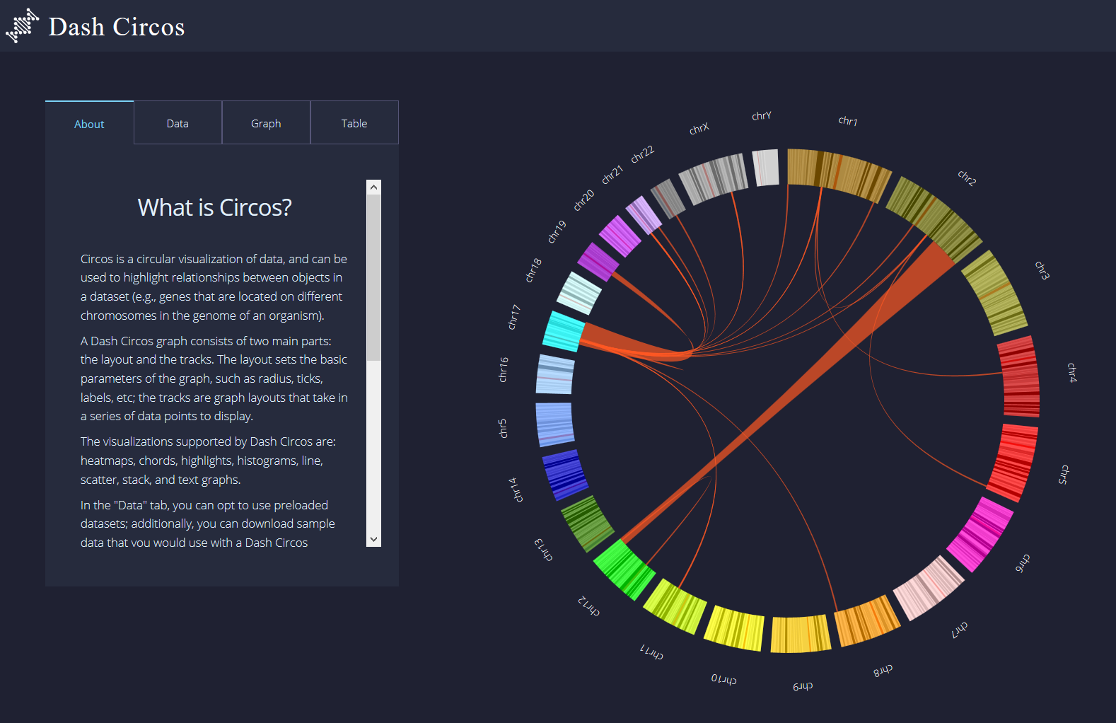
Visualize Circos: Human Chromosomes
https://dash.gallery/dash-circos
master/circos_sample_data/Layout.csv
https://github.com/gitbackspacer/data-visualisation-course/tree/master/circos_sample_data

Slide 25
Exercise 2: Simplest Circos
Data : https://github.com/gitbackspacer/data-visualisation-course/blob/master/circos_sample_data/table-05.txt

Slide 26
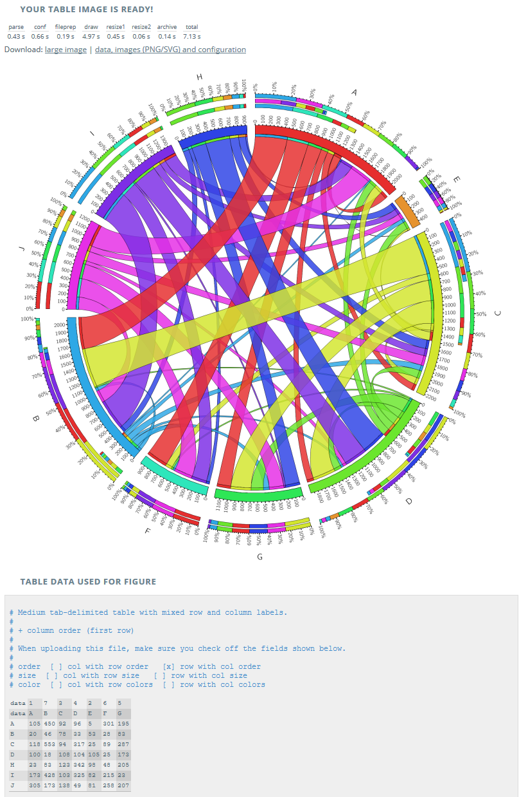
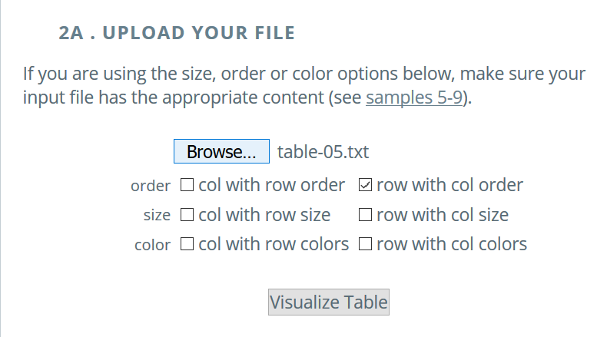
Generic Circos
http://mkweb.bcgsc.ca/tableviewer/samples/
http://mkweb.bcgsc.ca/tableviewer/

Slide 28
RNAseq data visualisation through IGV
Very popular NGS tool ‘Integrative Genomics Viewer’ Robinson et al (2011)
Integrated visualization tool for multiple data types and genome annotations.
Data from NGS analysis visualized .
Handles large datasets
Interactive and speedy visualization. Run locally on desktop
View multiple datasets in separate panels on the same panel(integrative).

Slide 29
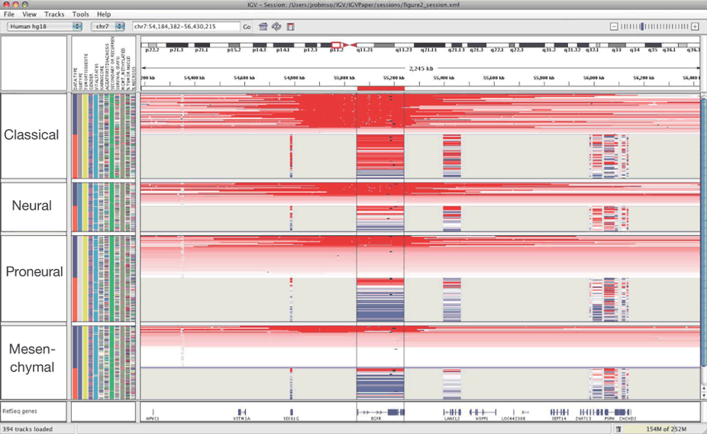
Impressive but busy https://www.nature.com/articles/nbt.1754/figures/1

Slide 30
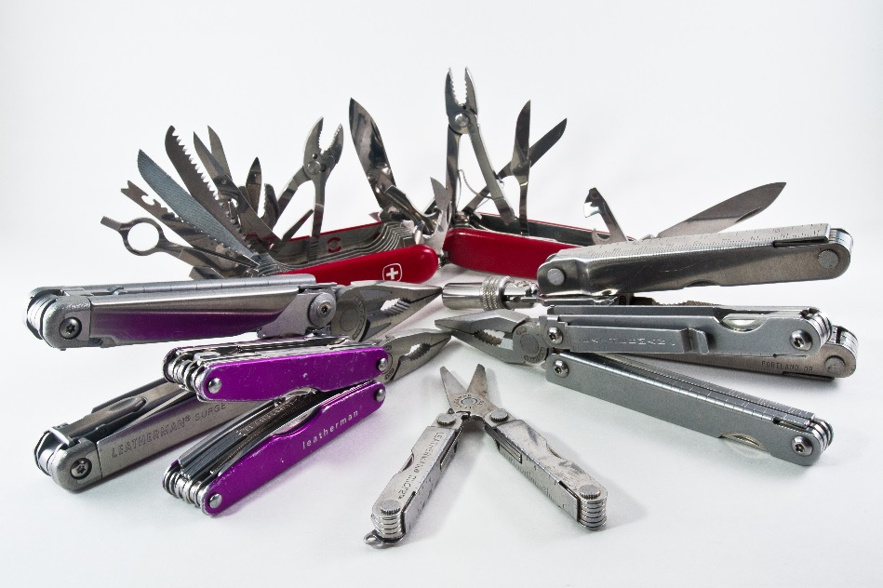
IGV DIY: diagnostics, read mapping, slice events, SNPs, Insertion , deletion, copy numbers, Errors
https://www.flickr.com/photos/pennuja/5363515039/

Slide 31
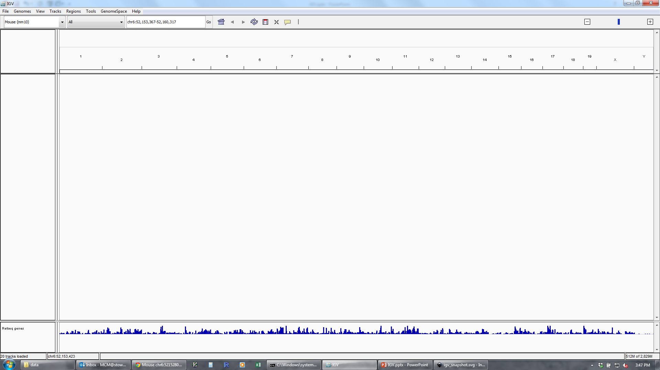
Basic Layout IGV
Genome
Navigation
Configuring Track Visibility
Data Tracks
Annotation Tracks

Slide 32
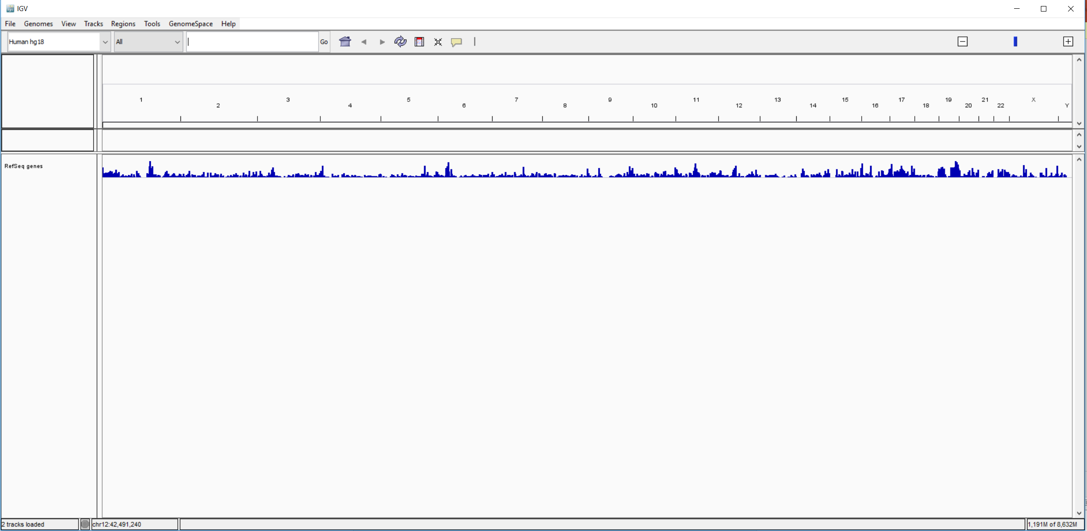
On a clean slate “Load your genome”

Slide 33

https://igv.org/app/

Slide 34
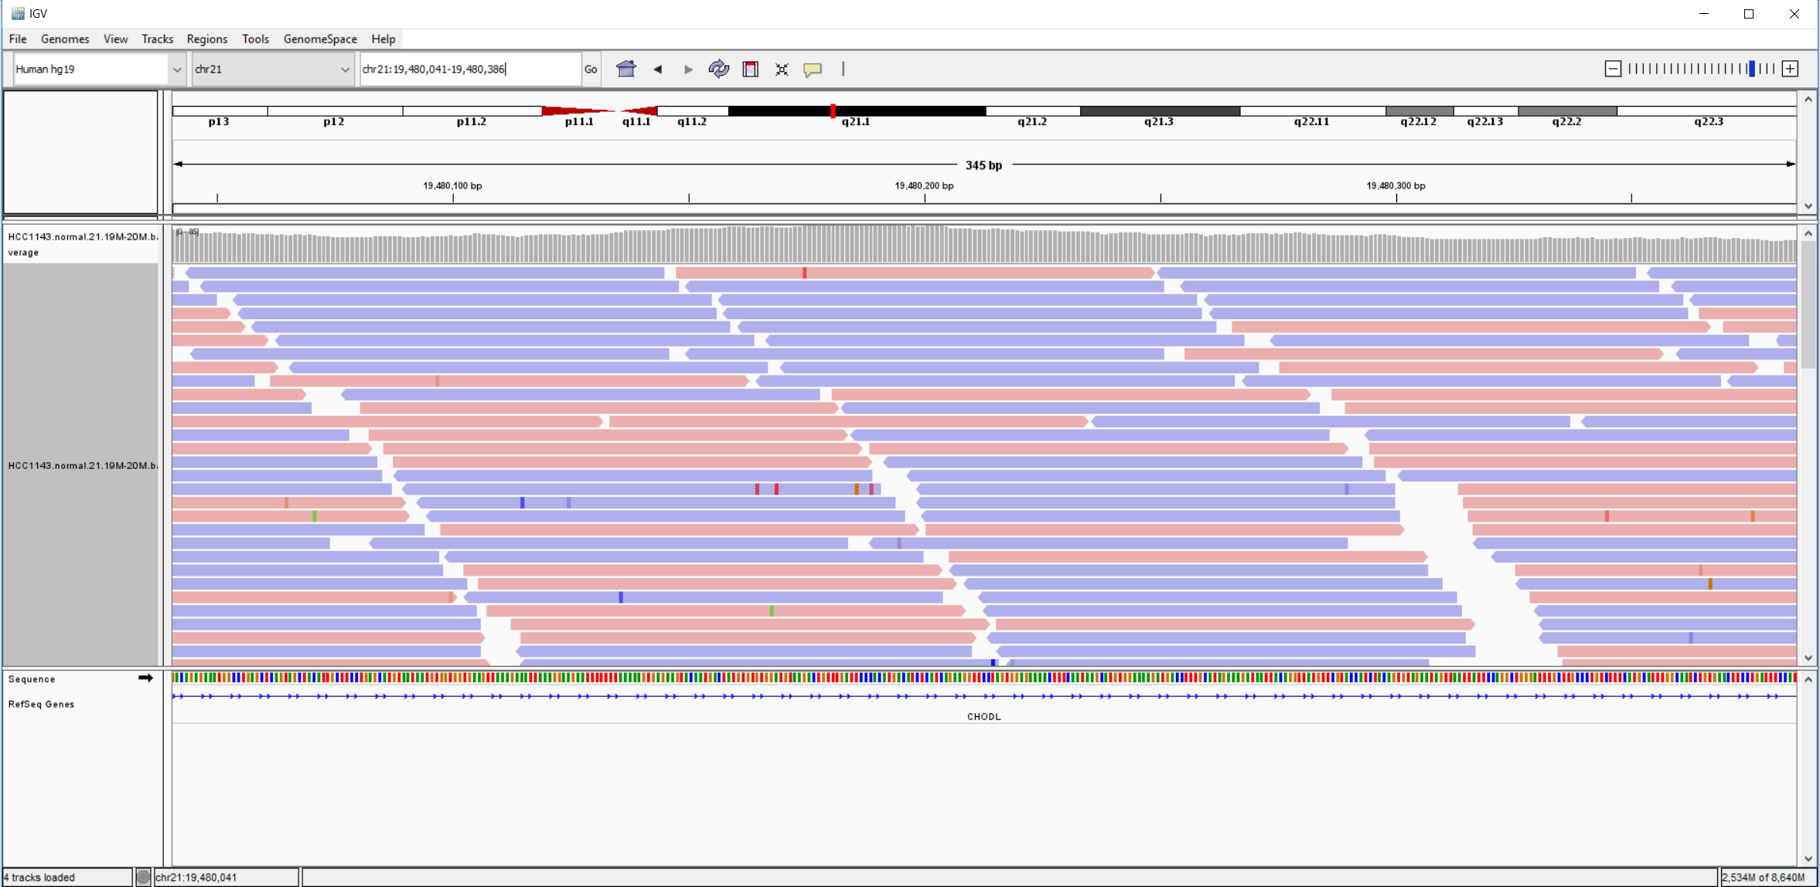
Load IGV loads Human hg19.
https://github.com/griffithlab/rnaseq_tutorial/wiki/IGV-Tutorial
Breast cancer cell line HCC1143 to visualize alignments, only a small portion of chr21 will be loaded (19M:20M) using File.. Load from File
“HCC1143.normal.21.19M-20M.bam”

Slide 35
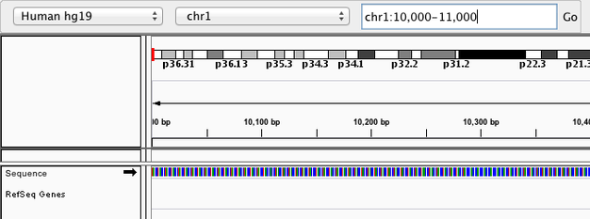
Navigate to a region

Slide 36
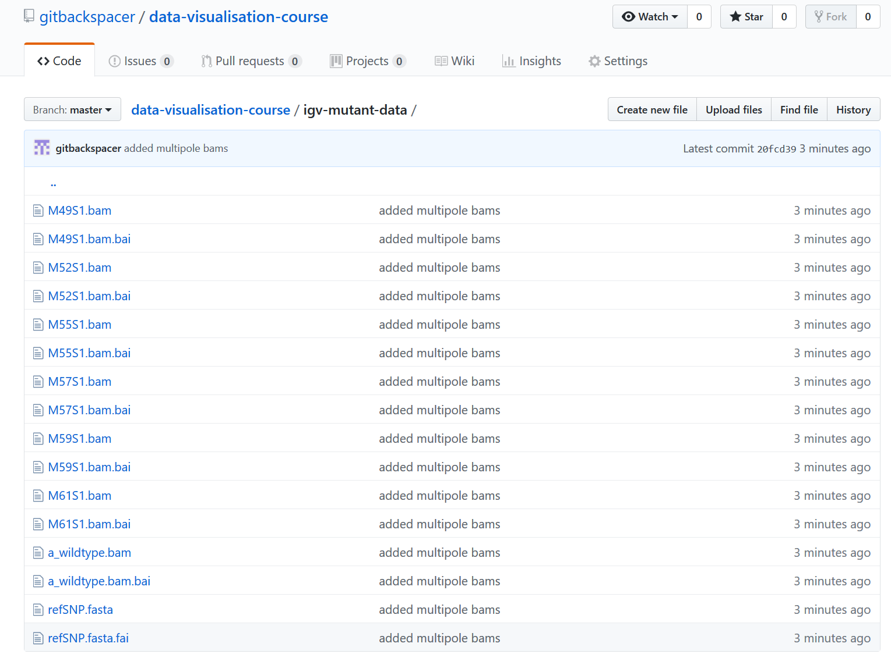
Exercise Visualise and Locate SNP
Data: https://github.com/gitbackspacer/data-visualisation-course/tree/master/igv-mutant-data

Slide 37
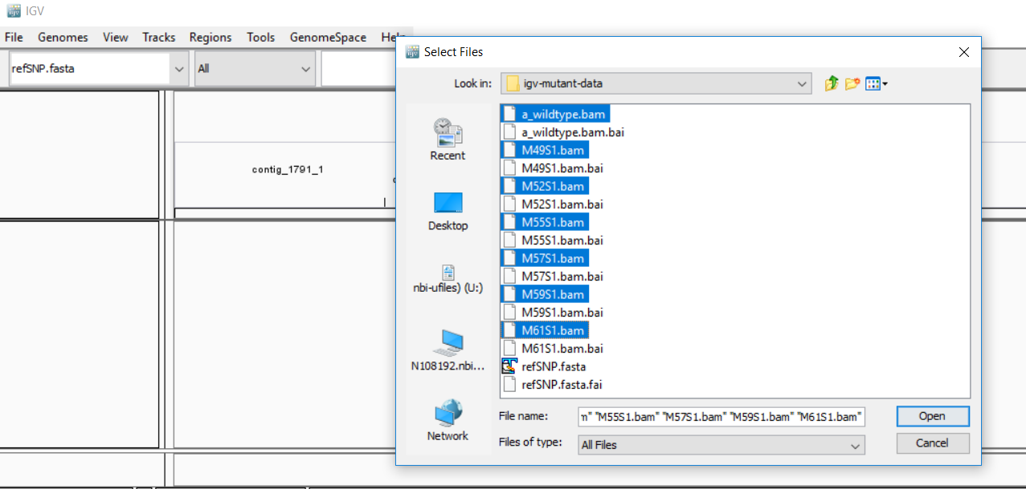
Use installed IGV or Webapp https://igv.org/app/

Slide 38
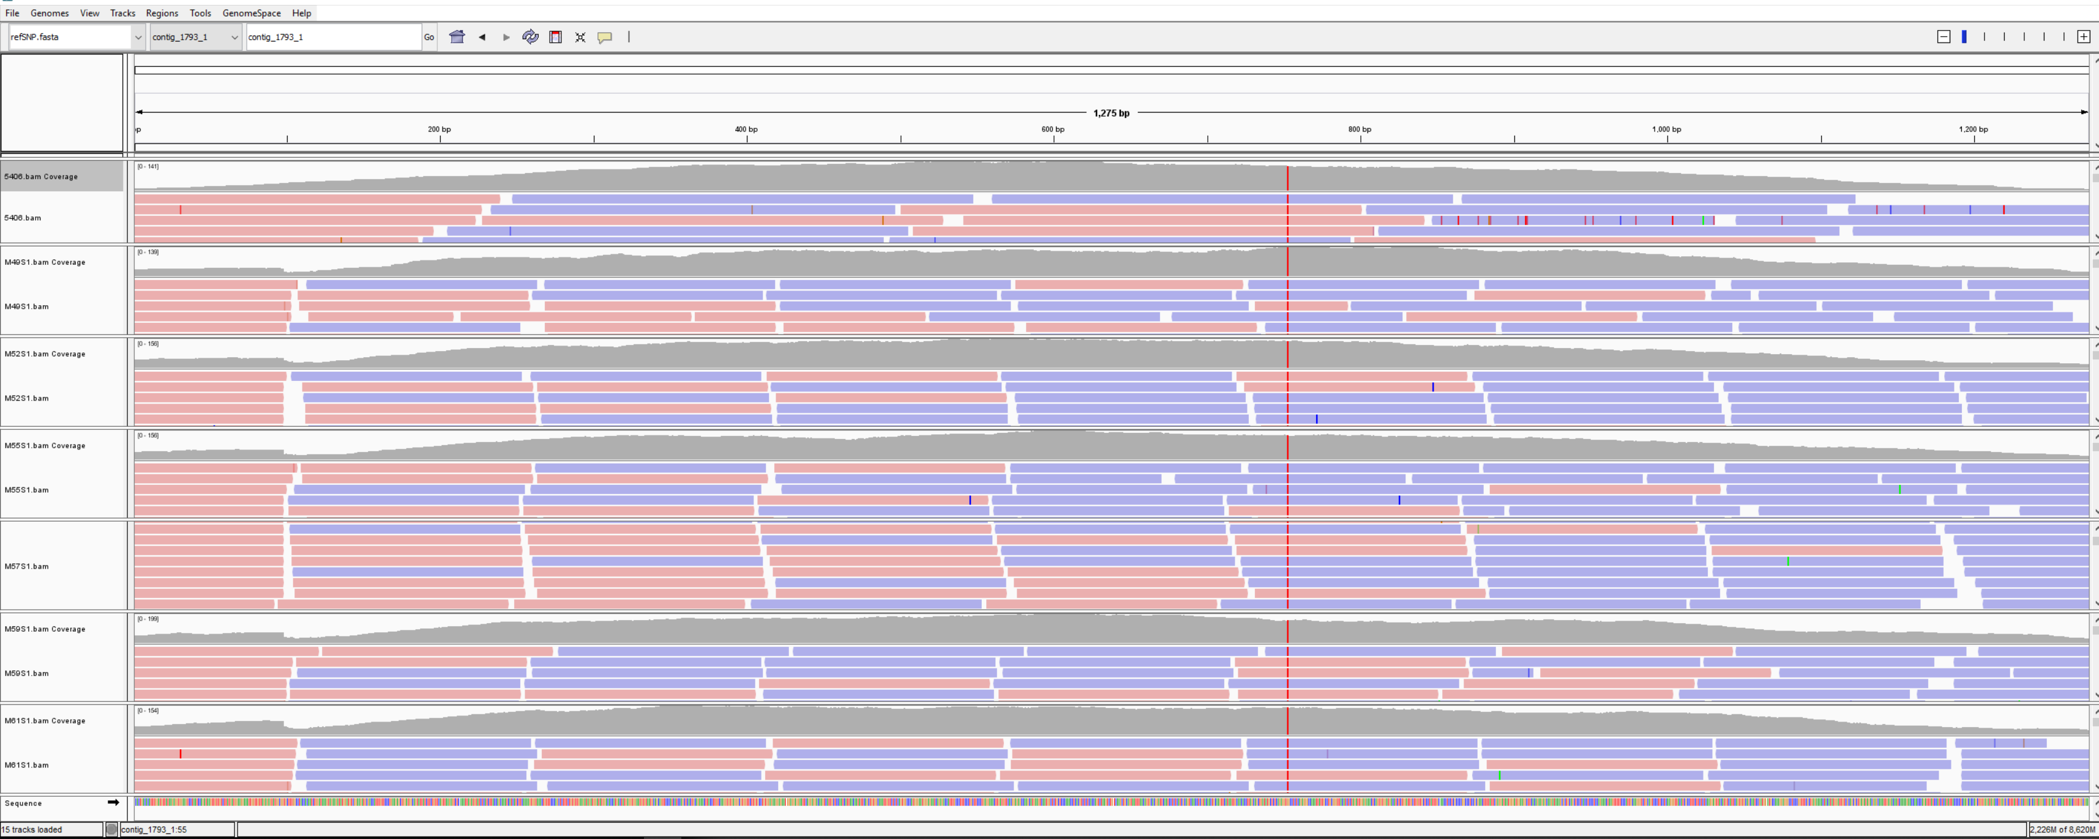
Wild type and 6 other mutants from an unknown species

Slide 39
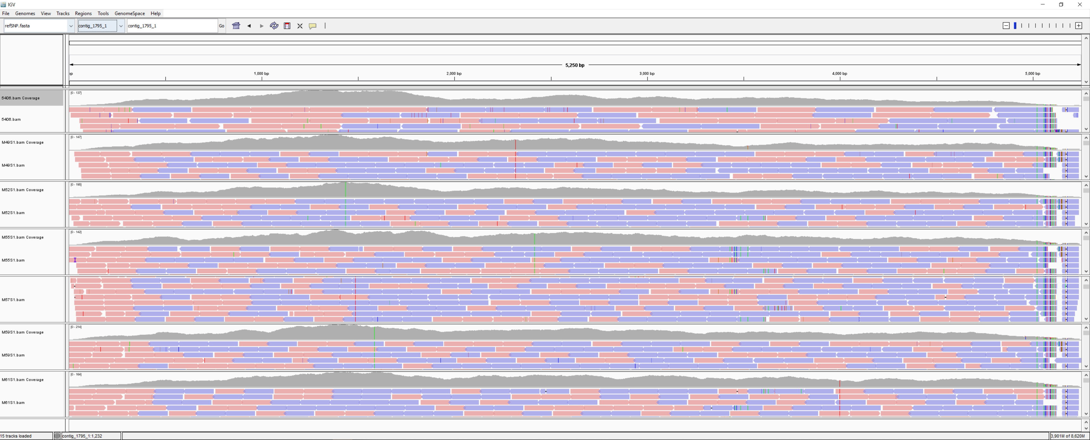

Slide 40
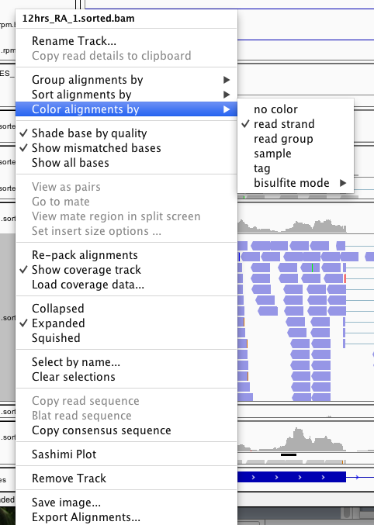
Right click on track name to change a bunch of stuff…

Slide 41
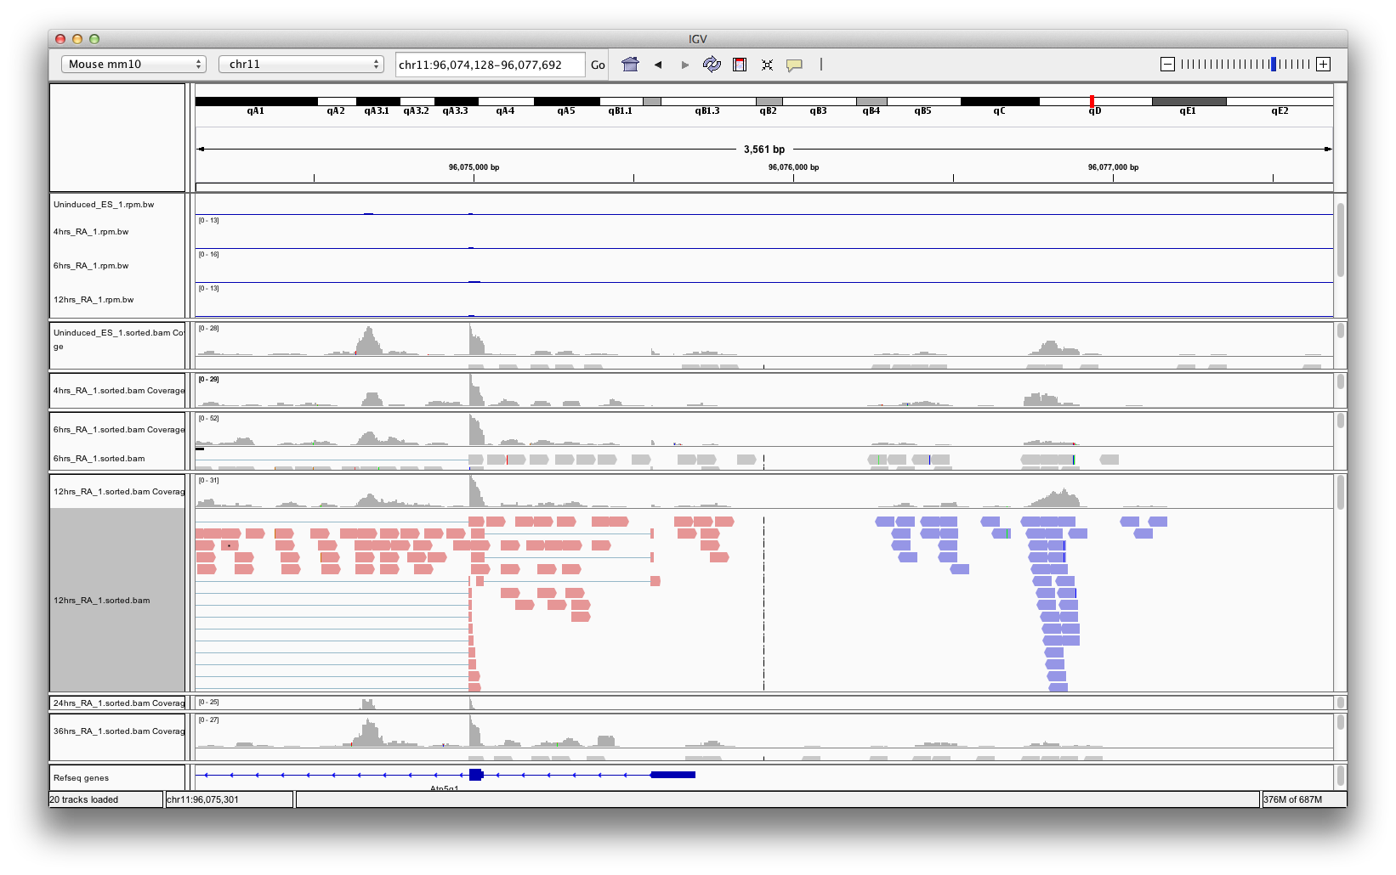
Color alignments by strand

Slide 42
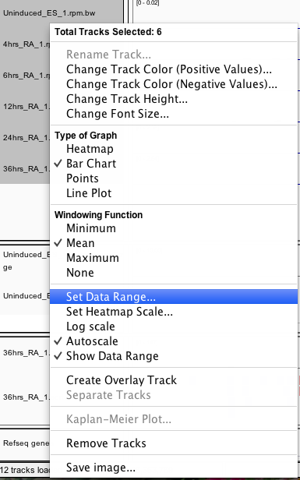
Scale

Slide 43
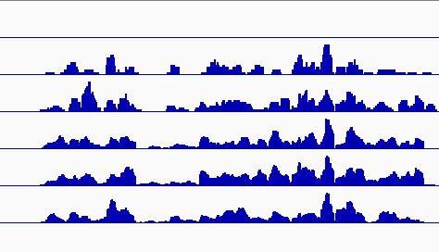
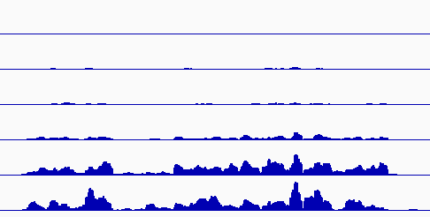
Know your scale…
Autoscale
Set Data Range

Slide 44
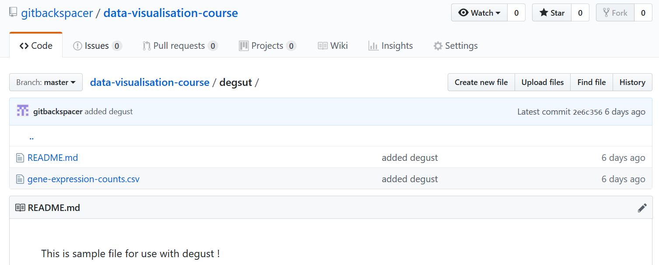
Gene Expression data: Exercise

Slide 45
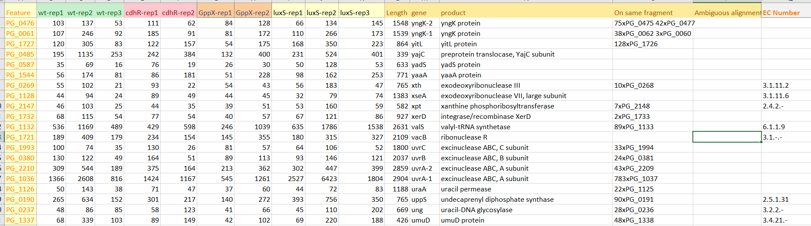
Gene Expression Data
We have count files for each gene as “CSV” file
http://degust.erc.monash.edu/degust/config.html?code=d24c2a88f917954853272af3e80cde5a

Slide 46
Degust
We can upload a CSV file containing your own analysis (eg. from Limma/Voom, edgeR or DESeq).
It is very interactive

Slide 47
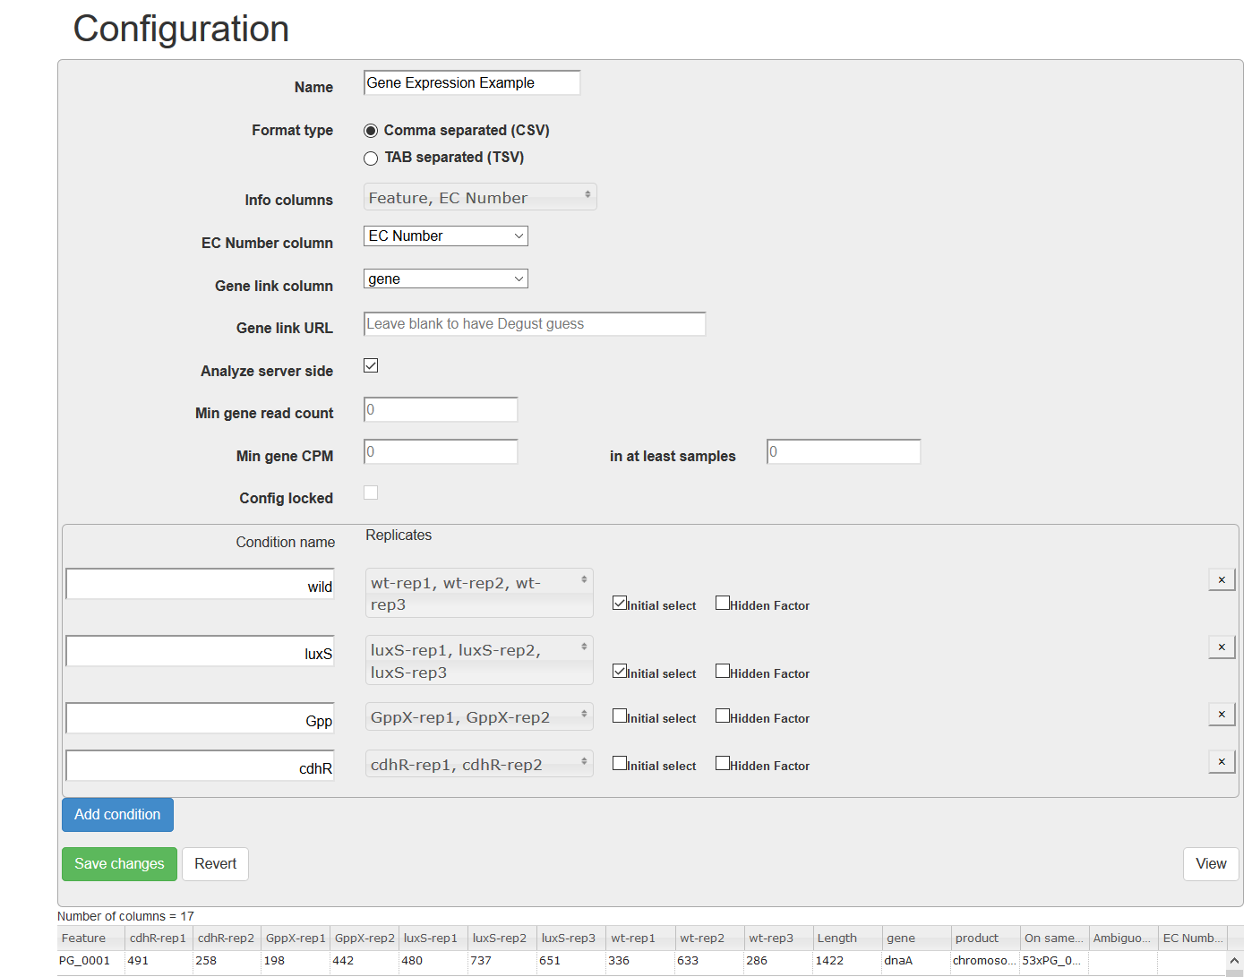
Replicate information

Slide 48
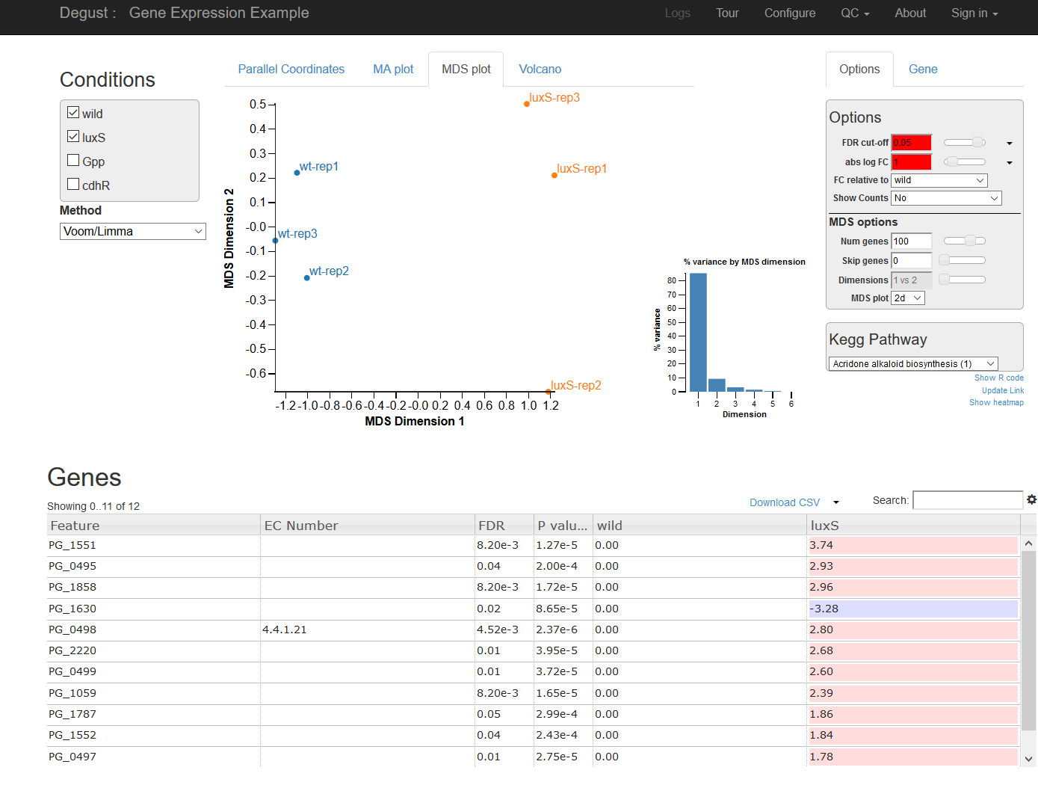
Check two conditions comparison: Verify replicate robustness

Slide 49
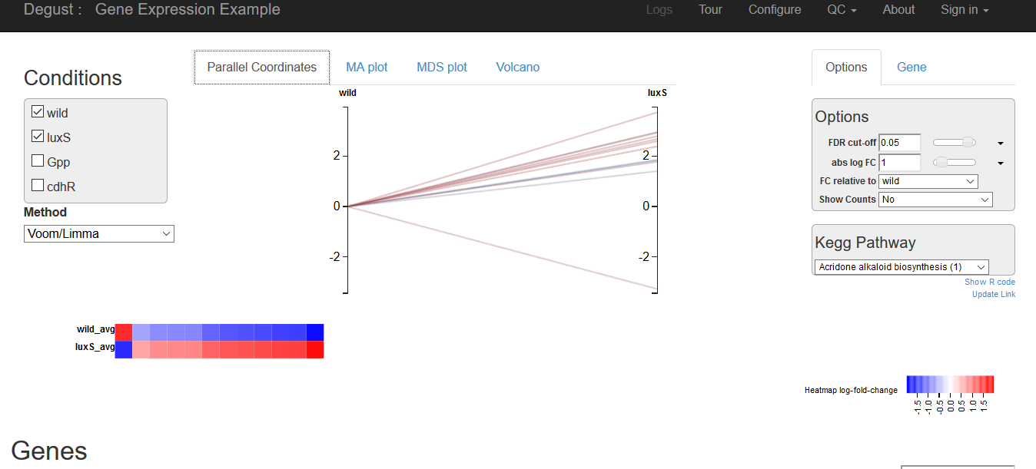

Slide 50
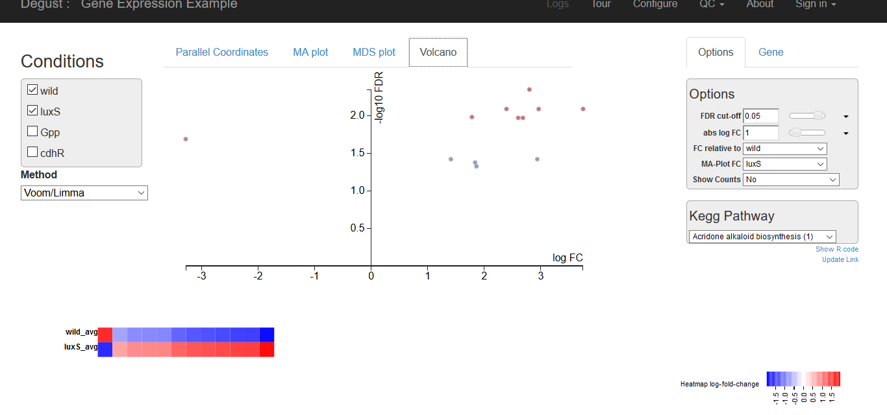

Slide 51
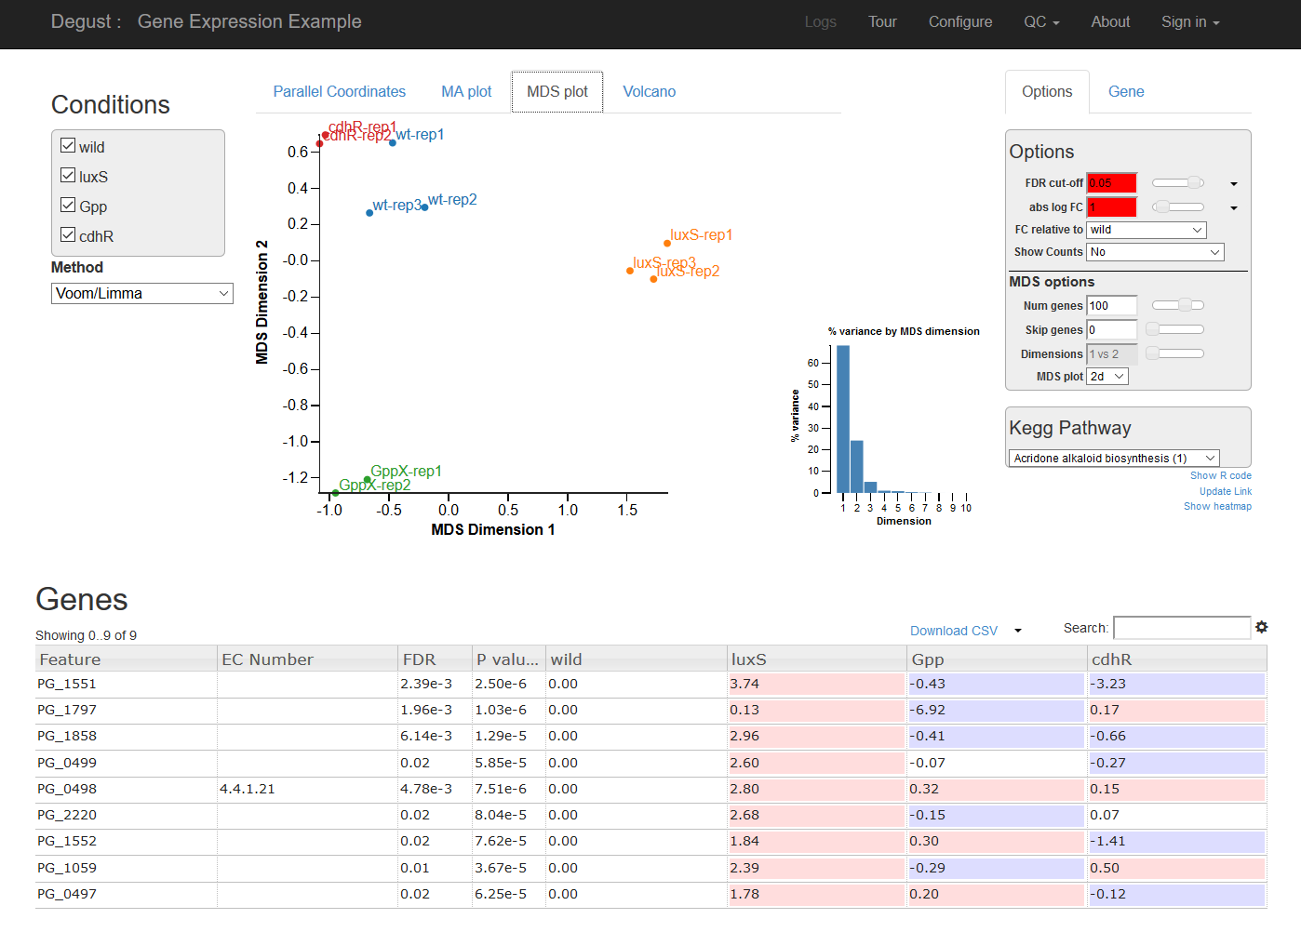
Switch all condition comparions

Slide 52
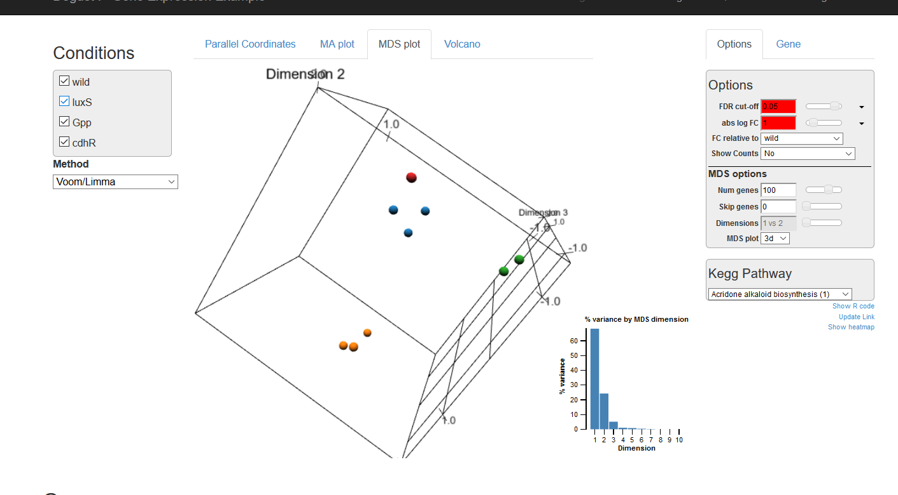
3D mds

Slide 53
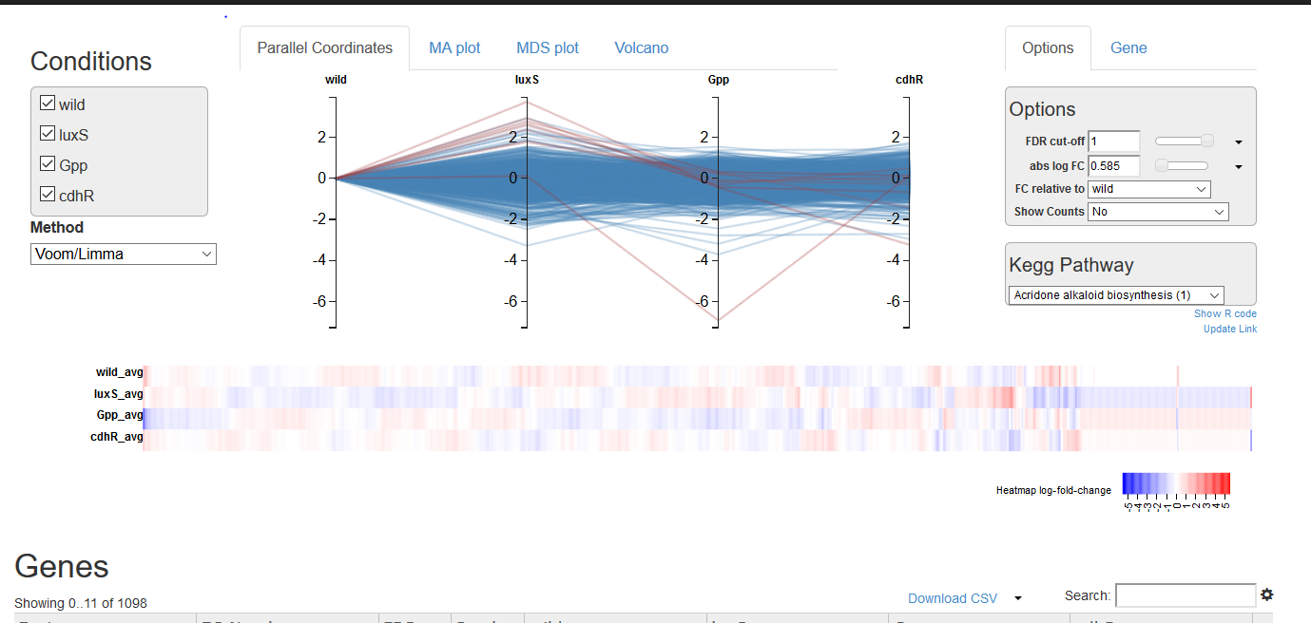
All conditions line plots; trends; can rearrange

Slide 54
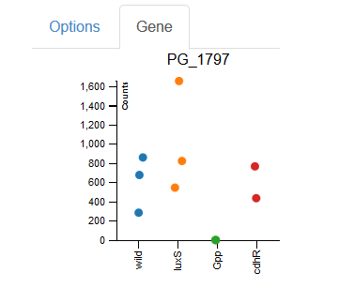
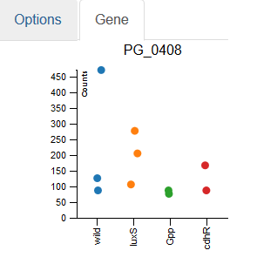
Per Gene spread option

Slide 55
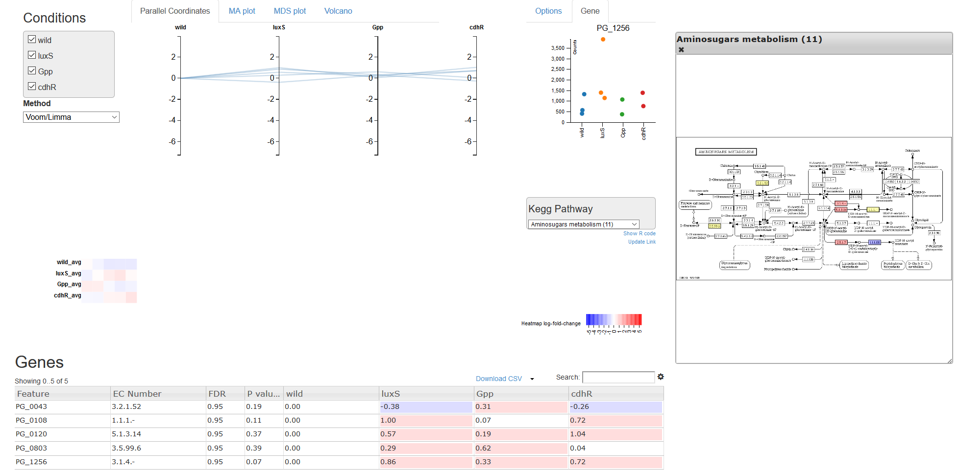
Highlight Gene on Kegg pathways

Slide 56
Go term Visualisation
http://www.webgestalt.org/2017/GOView/
GOView
View and compare Gene Ontology under DAG Structure
We will use sample file “sample.gvf” or https://github.com/gitbackspacer/data-visualisation-course/blob/master/sample.gvf

Slide 57
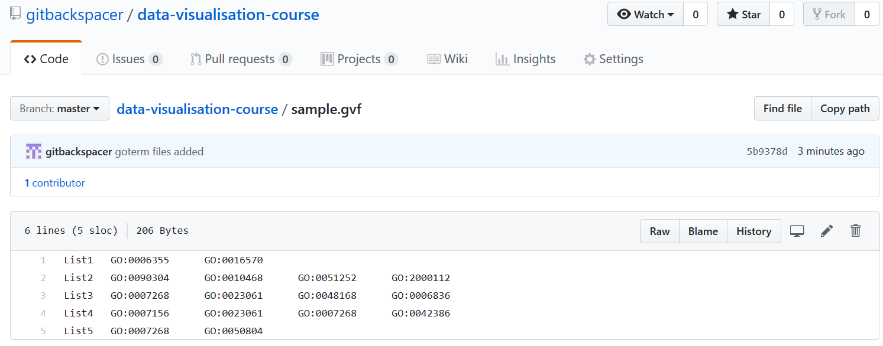
Go term File

Slide 58
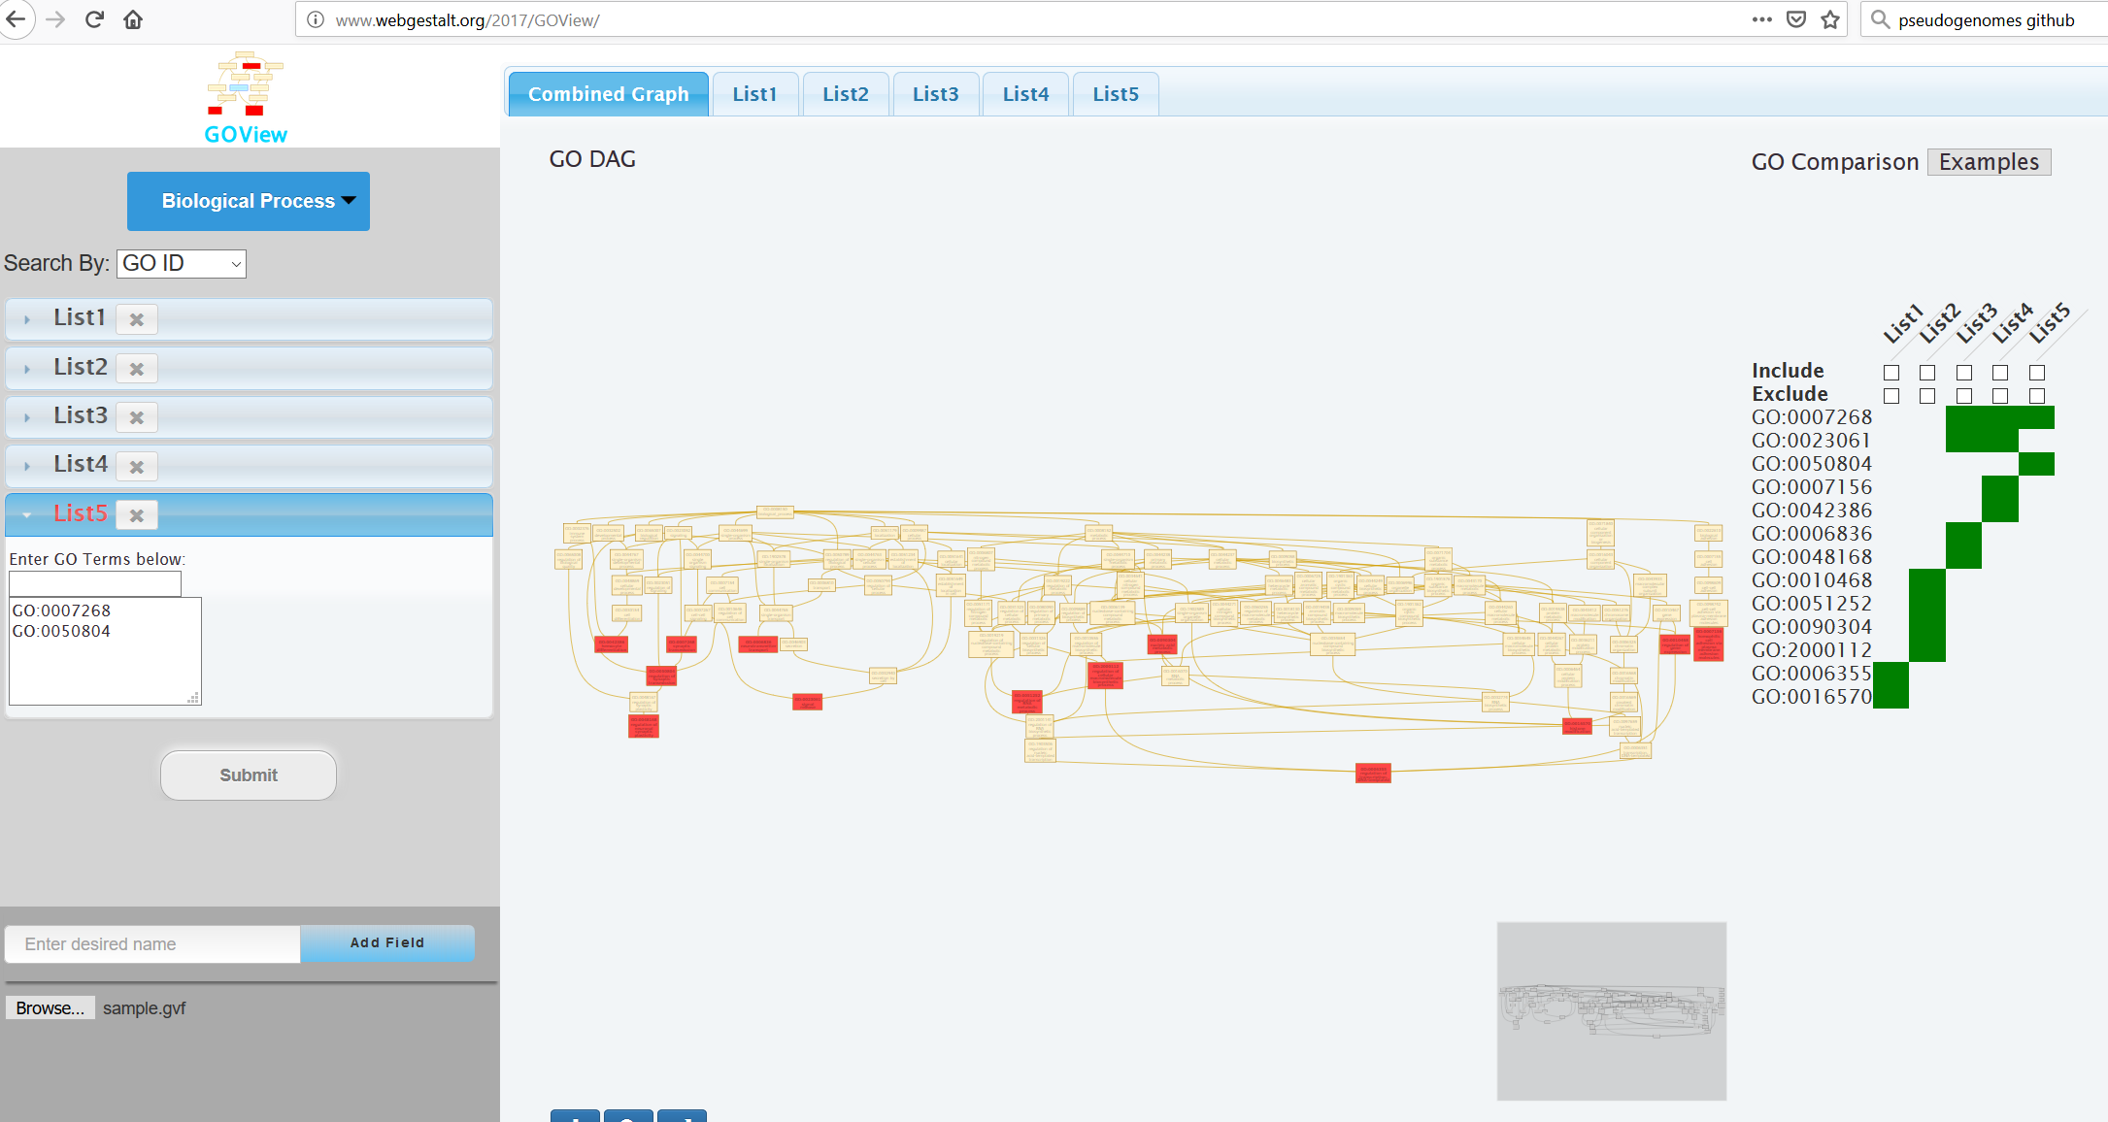

Slide 59
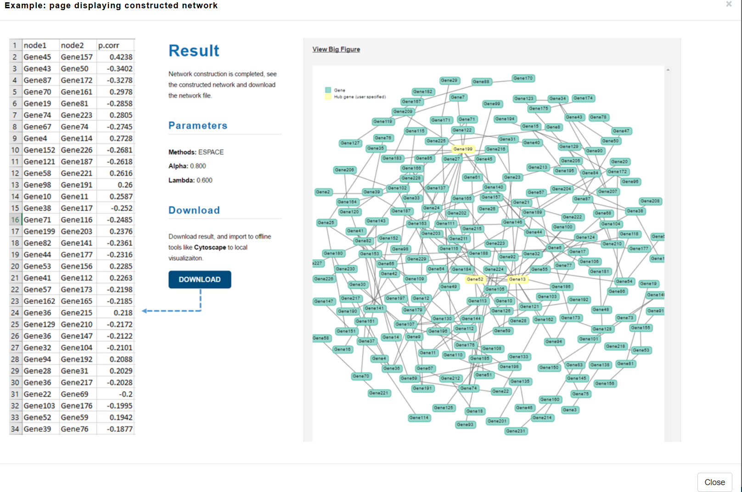
GeNeCK ( construct and visualise Gene regulatory networks)
GeNeCK: a web server for gene network construction and visualization Zhang etal, 2019

Slide 60
Meta Webserver and checkout demo
http://lce.biohpc.swmed.edu/geneck/index.php
Scale free networks

Slide 61
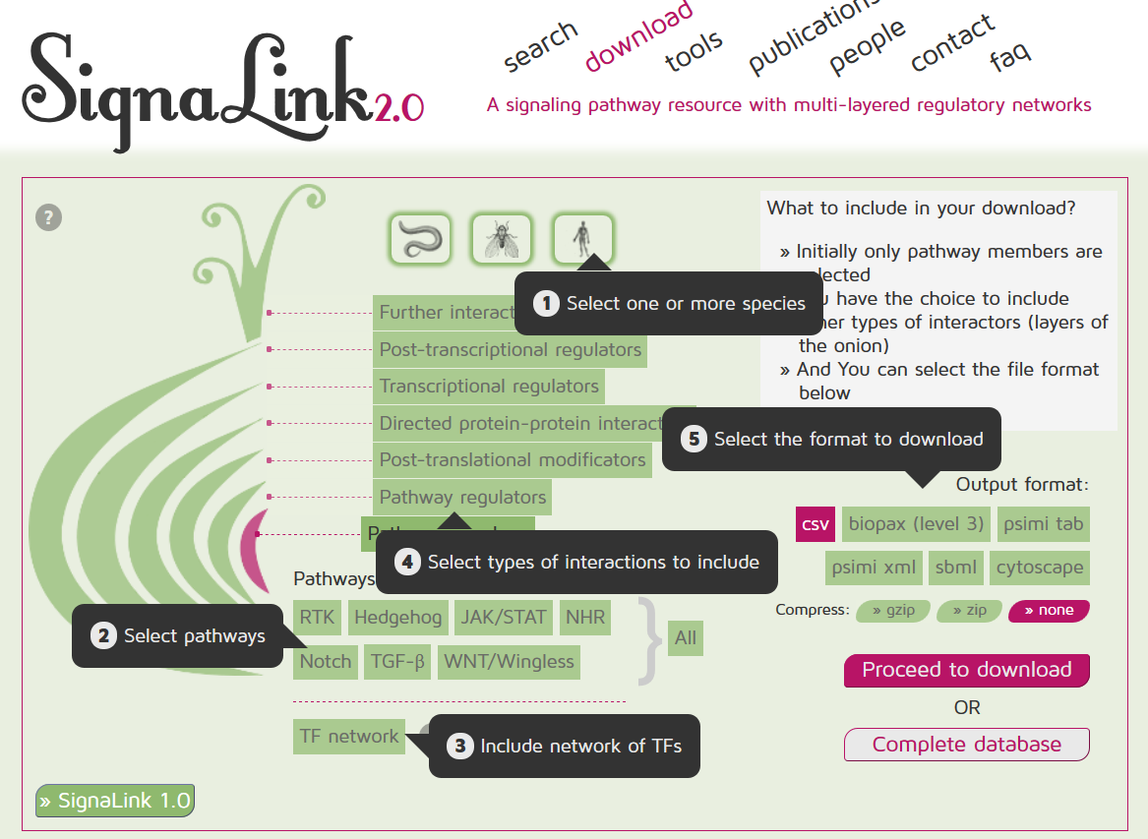

Slide 62
Data downloaded as “05062019-signalink-UTh27h.cys”
http://signalink.org/export/05062019-signalink-UTh27h.cys SignaLink export config: Species: H. sapiens Layers: Pathway members Pathway regulators Pathways: RTK Include TF network: Yes Range from pathway specific TF: 1 Format: cytoscape Compression: None

Slide 63
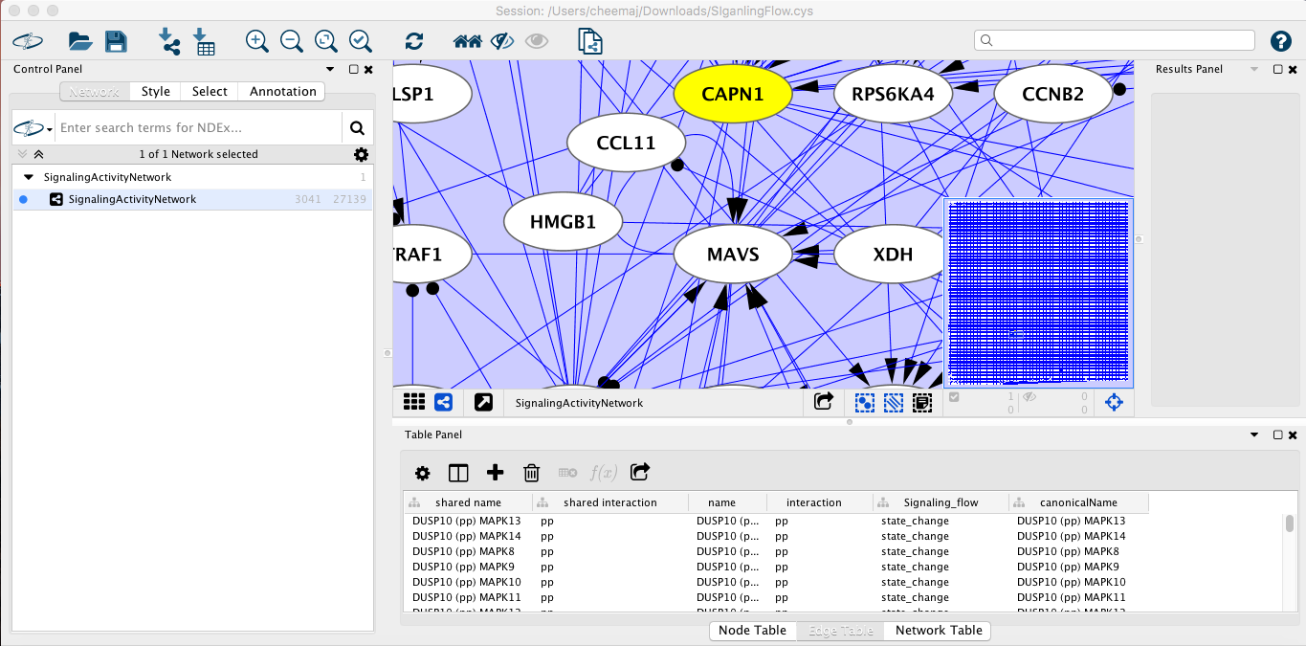
In cytoscape you can visualise the network

Slide 64
Interaction datal: HiC
Hi-Glass: web-based visual exploration and analysis of genome interaction maps
interface for
- Rapid
- multiplex
- multiscale navigation
http://higlass.io/app

Slide 65
Q & A
Discussion
Announcements
Feedback

